Slide 1

A Team-H Presentation
Because we hate WorkDay

Slide 2
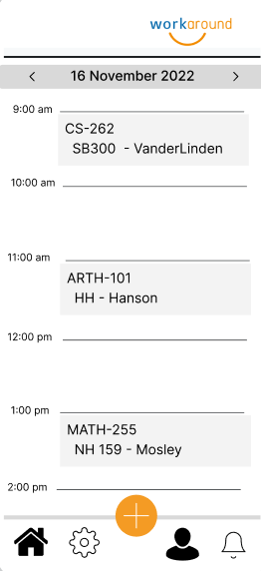
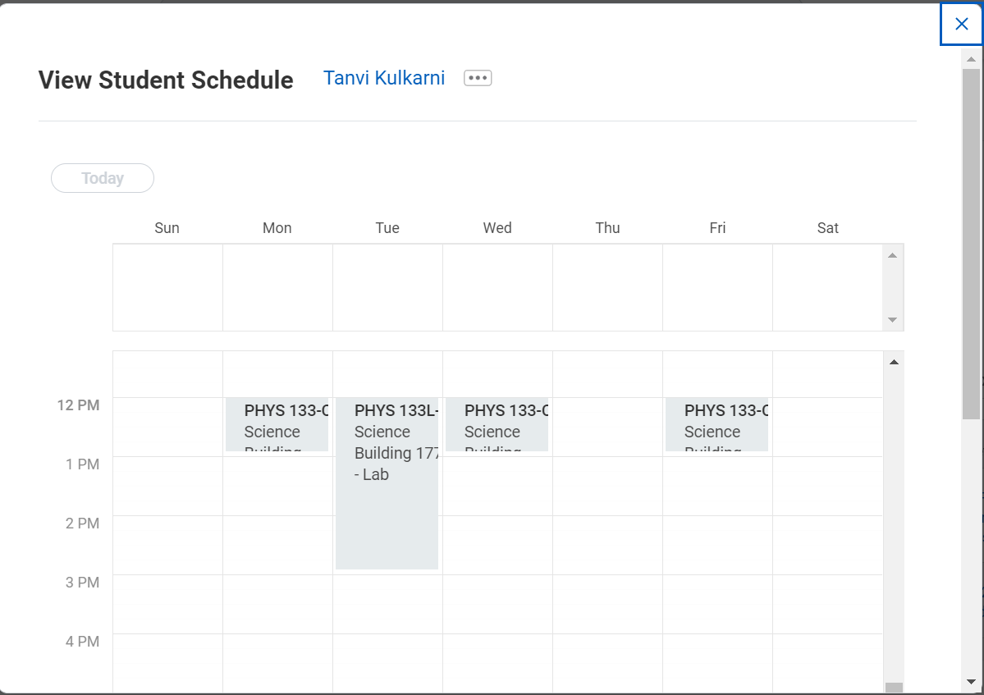

What our vision was…
Notes:
Intuitive UI

Slide 3
Here is how we accomplished it!
Notes:
Demo Slide

Slide 4
Online Help
Just in case you need it…
WorkAround online help document

Slide 5
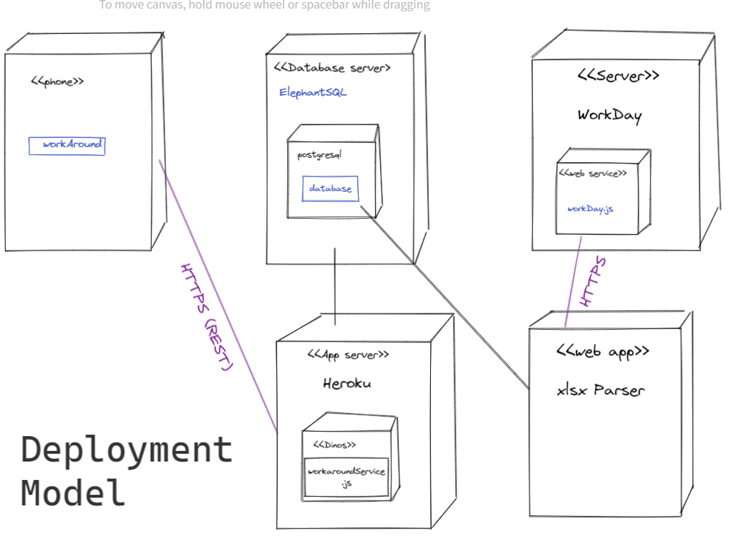

Slide 6
We understand the consequences…
Notes:
Assesment

Slide 7
But, we promise to keep improving.
Notes:
We can add UI images of the share and location features

Slide 8
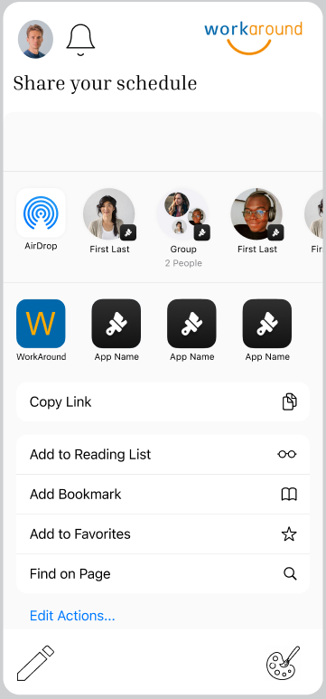

Slide 9
Location feature UI

Slide 10
Any questions?

